Slide 1
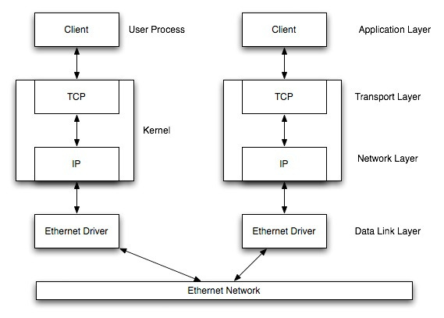
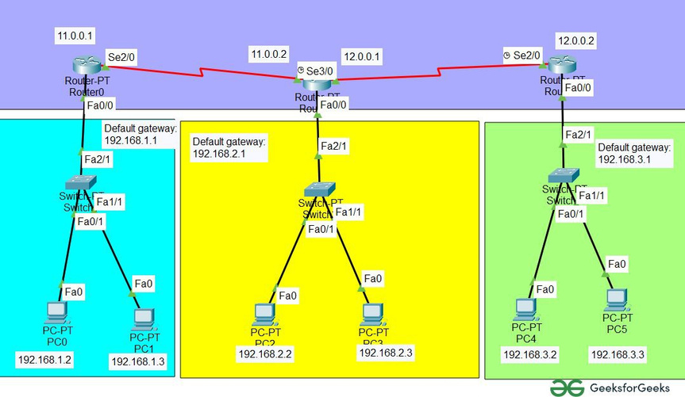
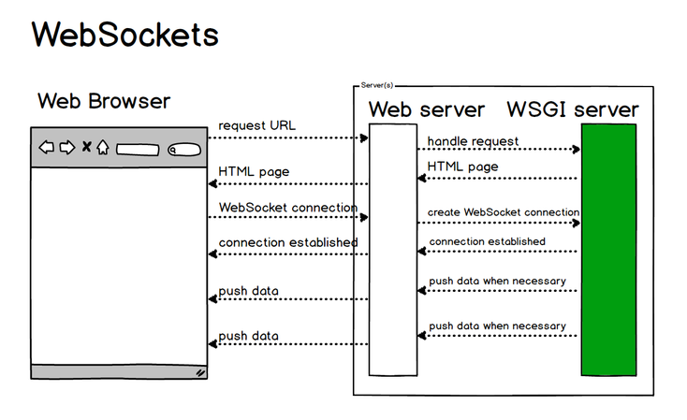
Week - 7,8 &9
Study of Socket Programming and Client – Server model
Implementation of Subnetting
HTTP web client program to download a web page using TCP sockets

